Slide 1
Candy Characteristics using Regression

Slide 2
Question of interest
The general goal is to find characteristics of popular candy brands and, subsequently, trying to come up with a business recommendation for a potential new candy. Here, I used a data resulting from an online survey asking the following question: “Please select which fun-size Halloween treat you would most want to receive as a trick-or-treater.”

Slide 3
History
Afterwards, the participant is asked to choose between two candies (randomly sampled from a total of 83 candies). By Oct. 27th, 2017, 8,371 different IP addresses voted on about 269,000 randomly generated matchups (i.e., on average, each participant voted for ~30 candies). Considering the amount of participants and number of votes it seems reasonable to assume that all candies were sufficiently matched-up against each other. Thus, the data set gives a good impression what candies are favored and which not. The outcome of the study provided the win rate [in percent] for each individual candy.

Slide 4
Data import: an Quality Assessment of data set
Data Understanding
Rows: 85 Columns: 13 $ candy <chr> "100 Grand", "3 Musketeers", "One dime", "One quarter… $ chocolate <lgl> TRUE, TRUE, FALSE, FALSE, FALSE, TRUE, TRUE, FALSE, F… $ fruity <lgl> FALSE, FALSE, FALSE, FALSE, TRUE, FALSE, FALSE, FALSE… $ caramel <lgl> TRUE, FALSE, FALSE, FALSE, FALSE, FALSE, TRUE, FALSE,… $ peanut_almond <lgl> FALSE, FALSE, FALSE, FALSE, FALSE, TRUE, TRUE, TRUE, … $ nougat <lgl> FALSE, TRUE, FALSE, FALSE, FALSE, FALSE, TRUE, FALSE,… $ rice_wafer_cooky <lgl> TRUE, FALSE, FALSE, FALSE, FALSE, FALSE, FALSE, FALSE… $ hard <lgl> FALSE, FALSE, FALSE, FALSE, FALSE, FALSE, FALSE, FALS… $ bar <lgl> TRUE, TRUE, FALSE, FALSE, FALSE, TRUE, TRUE, FALSE, F… $ multipiece <lgl> FALSE, FALSE, FALSE, FALSE, FALSE, FALSE, FALSE, TRUE… $ sugarpercent <dbl> 0.732, 0.604, 0.011, 0.011, 0.906, 0.465, 0.604, 0.31… $ pricepercent <dbl> 0.860, 0.511, 0.116, 0.511, 0.511, 0.767, 0.767, 0.51… $ winpercent <dbl> 66.97173, 67.60294, 32.26109, 46.11650, 52.34146, 50.…
The whole data set lists 85 different candy types along with 11 attributes and their win rate in percent (‘winpercent’) resulting from the online survey (data set is complete and has no missing values). Note that I chose for some of the attributes a more intuitive label (candy, peanut_almond, rice_wafer_cooky and multipiece were originally labeled differently).
Among the candy characteristics we find mainly binary attributes which can further be grouped to describe either a specific ingredient (‘chocolate’, ‘fruity’, ‘caramel’, ‘peanut_almond’, ‘nougat’ and ‘rice_wafer_cooky’) or some physical feature (‘hard’, ‘bar’, ‘multipiece’). Besides binary attributes, two numeric ones can be found (‘sugarpercent’ and ‘pricepercent’; both represent the unit percentile compared to the rest of the set).
With respect to the initial question, I decided to remove ‘pricepercent’ as the survey states: “… which (…) treat you would most want to receive”. Consequently, it seems highly questionable whether price played any role whether participants chose one candy over another. In other words, if people had to actually buy a candy (out of two options) in a store, the win rate of each candy may have been different.
The data set lists further ‘one dime’ and ‘one quarter’ as candies which is obviously incorrect. The coins were artificially added by the composer of the data set. As outlined in his corresponding article (see link), he wanted to show that any object could be used as input for a multiple regression model. For our purpose (finding favorable candy characteristics), both coins are certainly of no use.
Based on the observations above, both coins and the attribute ‘pricepercent’ has been removed from data set. Afterwards, 83 candy brands and 10 characteristics (+ ‘winpercent’) remained.
Rows: 83 Columns: 12 $ candy <chr> "100 Grand", "3 Musketeers", "Air Heads", "Almond Joy… $ chocolate <lgl> TRUE, TRUE, FALSE, TRUE, TRUE, FALSE, FALSE, FALSE, T… $ fruity <lgl> FALSE, FALSE, TRUE, FALSE, FALSE, FALSE, FALSE, TRUE,… $ caramel <lgl> TRUE, FALSE, FALSE, FALSE, TRUE, FALSE, FALSE, TRUE, … $ peanut_almond <lgl> FALSE, FALSE, FALSE, TRUE, TRUE, TRUE, FALSE, FALSE, … $ nougat <lgl> FALSE, TRUE, FALSE, FALSE, TRUE, FALSE, FALSE, FALSE,… $ rice_wafer_cooky <lgl> TRUE, FALSE, FALSE, FALSE, FALSE, FALSE, FALSE, FALSE… $ hard <lgl> FALSE, FALSE, FALSE, FALSE, FALSE, FALSE, FALSE, FALS… $ bar <lgl> TRUE, TRUE, FALSE, TRUE, TRUE, FALSE, FALSE, FALSE, T… $ multipiece <lgl> FALSE, FALSE, FALSE, FALSE, FALSE, TRUE, TRUE, FALSE,… $ sugarpercent <dbl> 0.732, 0.604, 0.906, 0.465, 0.604, 0.313, 0.906, 0.60… $ winpercent <dbl> 66.97173, 67.60294, 52.34146, 50.34755, 56.91455, 23.…

Slide 5
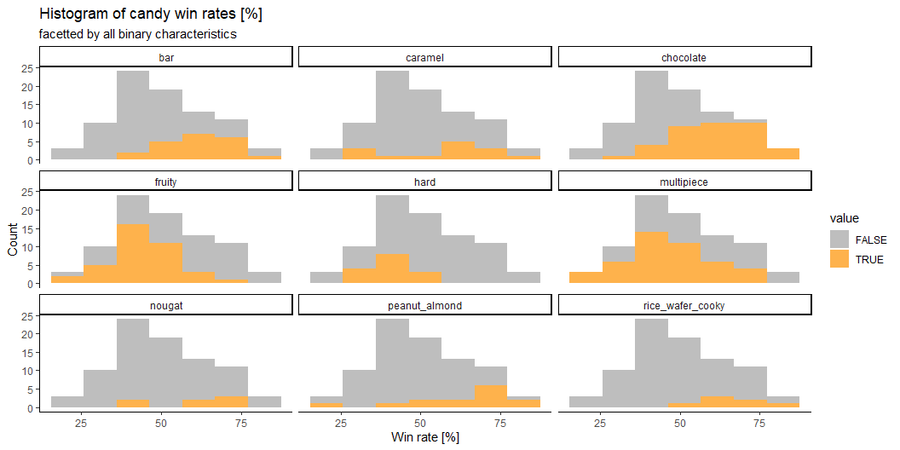
Exploratory data analysis
Binary candy characteristics
The table below summarizes the binary characteristics. We see that particularly the frequency differs among all characteristics (ranging between 7 for ‘nougat’ and ‘rice_wafer_cooky’ and 39 for ‘multipiece’). See also the ‘logical.mean’ column showing the proportion of TRUE´s for each category).
# A tibble: 9 × 4 skim_variable complete_rate logical.mean logical.count <chr> <dbl> <dbl> <chr> 1 chocolate 1 0.446 FAL: 46, TRU: 37 2 fruity 1 0.458 FAL: 45, TRU: 38 3 caramel 1 0.169 FAL: 69, TRU: 14 4 peanut_almond 1 0.169 FAL: 69, TRU: 14 5 nougat 1 0.0843 FAL: 76, TRU: 7 6 rice_wafer_cooky 1 0.0843 FAL: 76, TRU: 7 7 hard 1 0.181 FAL: 68, TRU: 15 8 bar 1 0.253 FAL: 62, TRU: 21 9 multipiece 1 0.530 TRU: 44, FAL: 39
For a first impression how each binary attributes relates to candy win rates, I created numerous histograms of the win rate facetted by attribute (Figure below). For reference, each subplot shows also the win rate histogram of the whole data. Not only shows this the proportion of each characteristic with respect to the entire data set but allows also a first visual impression whether specific attributes tend to have lower or higher win rates. As noted before, only a few candies contain ‘nougat’ and ‘rice_wafer_cooky’ whereas ‘chocolate’ and ‘fruity’ are more common ingredients. Hints for a good candy may already be derived from the histograms of ‘chocolate’ and ‘peanut_almond’ as they cover mainly areas of higher win rates. On the contrary, ‘fruity’ and ‘hard’ seem less indicative for a good candy.
Figure - Histograms of candy win rates (in %) for each binary characteristic. Overall shape of each histogram reflects the entire data set whereby corresponding blue parts represent only the proportion of the individual characteristic.

Slide 6
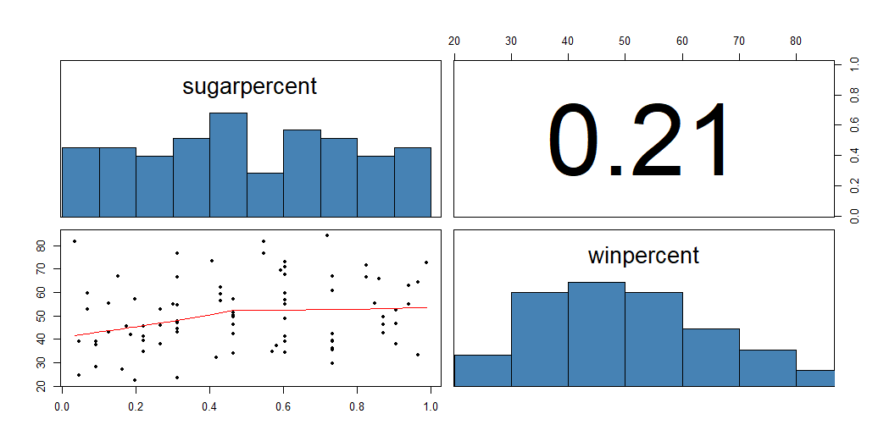
Numeric candy characteristics
The only remaining numeric candy characteristic ‘sugarpercent’ is visualized below. Here, we see that ‘sugarpercent’ is fairly evenly distributed along all ‘winrates’ (top left) and indicates a poor correlation with respect to ‘winpercent’ (r = 0.21; top right). Nonetheless, as suggested by the loess curve (bottom left), ‘sugarpercent’ may linearly influence ‘winpercent’ rather within a certain (0.0 to 0.5). Therefore, 0.5 ‘sugarpercent’ may mark some sugar threshold value that some of the most favorite candies exceed.
Figure - Top left and bottom right: histograms of ‘sugarpercent’ and ‘winpercent’, paged.print=TRUE, respectively. Bottom left: scatter plot between ‘sugarpercent’ and ‘winpercent’ (including loess curve). Top right: Pearson´s r

Slide 7
Multicollinearity among predictor variables?
Below I created a matrix of correlation coefficients among the available attributes (note that I transformed all logical into dummy variables). Here, highest correlation can be found between chocolate and fruity (r = -0.78), i.e., ‘chocolate’ is rarely combined with ‘fruity’ in a candy. We bear that information in mind when applying a multiple regression mode for predicting candy´s win rate.

Slide 8
Model selection
Multiple regression
Raw model (using all characteristics as predictors)
I applied a multiple regression model to evaluate whether candy characteristics can be used to predict the win rates of the online survey (using the cleaned data set). The residuals (or errors) suggest that 50% of the candy ‘winrate’ prediction were off by lower than ~6 %. Maximum errors were on the order of ~20%. Among all predictors, chocolate and fruity seem to have the highest positive impact on win rate (on average, 20 und 11 %, respectively). Even though we already gained some insights about the most influential characteristics, the model´s overall performance is rather poor to moderate since only about half of the win rate´s variability can be explained by the involved candy characteristics (adjusted R² of 0.47).
Call: lm(formula = winpercent ~ ., data = candy_cleaned[-1]) Residuals: Min 1Q Median 3Q Max -20.6824 -6.3101 0.3662 6.0192 24.2836 Coefficients: Estimate Std. Error t value Pr(>|t|) (Intercept) 30.7539 4.9806 6.175 3.53e-08 *** chocolateTRUE 20.4167 4.0935 4.988 4.09e-06 *** fruityTRUE 11.0367 4.0881 2.700 0.00864 ** caramelTRUE 2.4403 3.6959 0.660 0.51120 peanut_almondTRUE 9.8877 3.6125 2.737 0.00780 ** nougatTRUE 1.7957 5.6416 0.318 0.75118 rice_wafer_cookyTRUE 8.5485 5.2792 1.619 0.10976 hardTRUE -5.5352 3.4737 -1.593 0.11544 barTRUE -0.4570 4.9042 -0.093 0.92602 multipieceTRUE -0.2633 3.1859 -0.083 0.93436 sugarpercent 8.1247 4.4843 1.812 0.07418 . --- Signif. codes: 0 '***' 0.001 '**' 0.01 '*' 0.05 '.' 0.1 ' ' 1 Residual standard error: 10.74 on 72 degrees of freedom Multiple R-squared: 0.5346, Adjusted R-squared: 0.47 F-statistic: 8.271 on 10 and 72 DF, p-value: 9.033e-09

Slide 9
Improving model performance
Based on the statistical output of the raw model, one might suggest that adding chocolate and fruity may result in a particularly favorable candy. However, both these attributes correlate with each other (as discussed before) and, therefore, induce multicollinearity into the model. Intuitively,‘chocolate’ and ‘fruity’ seems a rather odd combination. Consequently, I looked up candies combining ‘fruity’ with ‘chocolate’ but also with other taste-like characteristics like ‘caramel’, ‘peanut_almond’, ‘nougat’ and ‘rice_wafer_cooky’.
# A tibble: 2 × 8 candy chocolate fruity caramel peanut_almond nougat rice_wafer_cooky winpercent <chr> <lgl> <lgl> <lgl> <lgl> <lgl> <lgl> <dbl> 1 Caramel Apple Pops FALSE TRUE TRUE FALSE FALSE FALSE 34.5 2 Tootsie Pop TRUE TRUE FALSE FALSE FALSE FALSE 49.0

Slide 10
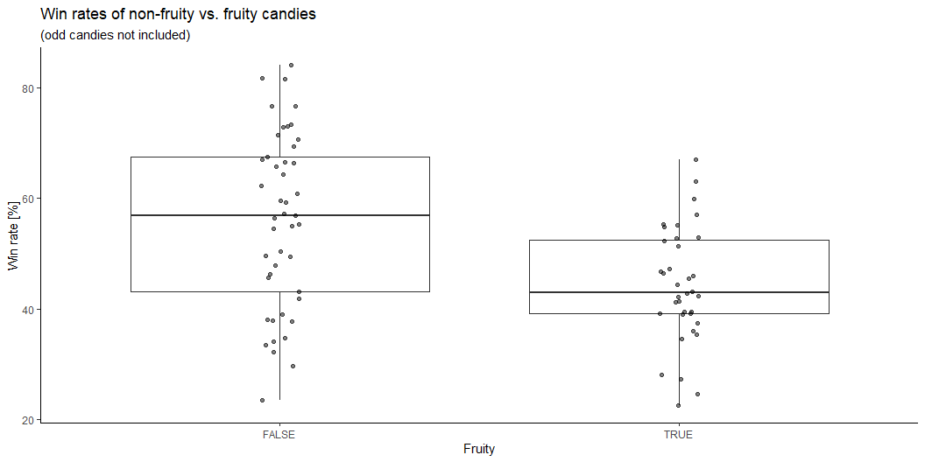
Assumption validation
Filtering the candies accordingly results in only two candies (‘Caramel Apple Pops’ and ‘Tootsie Pop’; see output above) fulfilling these criteria. Both candies have rather low win rates (35 and 49%). Combining ‘fruity’ with other taste-like characteristics seems therefore not only uncommon (probably for a reason) but, if combined anyway, results in rather unsuccessful candies. With respect to our initial goal (finding favorable candy attributes), I suggest to remove both odd candies from the data set. Removing these candies further avoids the observed multicollinearity between ‘chocolate’ and ‘fruity’ and also cleanly splits up the data set in two subgroups (either exclusively fruity or exclusively non-fruity).
# A tibble: 2 × 2 # Groups: fruity [2] fruity n <lgl> <int> 1 FALSE 45 2 TRUE 36
Now, the fruity attribute splits up the data set yielding 45 non-fruity and 36 fruity candies. Based on these distinctively different groups (which mutually exclude each other) I evaluated first which group may be the best candidate for the new candy product. The boxplots below show the distribution of candy win rate for each group suggesting that non-fruity candies should be favored over fruity candies.

Slide 11
Applying a t test between group means statistically backs up our findings (see below). Consequently, a non-fruity candy seems to be a reasonable choice when inventing successful new candy product (on average, a 12% higher win rate; p < 0.05)
Two Sample t-test data: winpercent by fruity t = 3.8543, df = 79, p-value = 0.0001175 alternative hypothesis: true difference in means between group FALSE and group TRUE is greater than 0 95 percent confidence interval: 6.700561 Inf sample estimates: mean in group FALSE mean in group TRUE 56.04438 44.25138
I focused therefore only on the 47 exclusively non-fruity candies and applied, again, the multiple regression (see below). Overall, an improved model performance can be noted (adjusted R² increased from 0.47 to 0.52).
Call: lm(formula = winpercent ~ ., data = candy_nonfruity[, -1]) Residuals: Min 1Q Median 3Q Max -18.940 -5.459 2.375 6.007 15.030 Coefficients: Estimate Std. Error t value Pr(>|t|) (Intercept) 33.9652 7.0258 4.834 2.64e-05 *** chocolateTRUE 23.9786 4.8400 4.954 1.84e-05 *** caramelTRUE 3.1475 4.0863 0.770 0.4463 peanut_almondTRUE 8.9775 3.7874 2.370 0.0234 * nougatTRUE 2.1528 5.8125 0.370 0.7133 rice_wafer_cookyTRUE 8.4499 5.4154 1.560 0.1277 hardTRUE 0.6015 9.1229 0.066 0.9478 barTRUE -7.3160 6.0913 -1.201 0.2378 multipieceTRUE -8.4767 5.4993 -1.541 0.1322 sugarpercent 8.5009 6.9368 1.225 0.2286 --- Signif. codes: 0 '***' 0.001 '**' 0.01 '*' 0.05 '.' 0.1 ' ' 1 Residual standard error: 10.97 on 35 degrees of freedom Multiple R-squared: 0.6174, Adjusted R-squared: 0.519 F-statistic: 6.274 on 9 and 35 DF, p-value: 3.053e-05
When assessing in detail the influence of the individual characteristics on win rate, we notice that ‘caramel’, ‘nougat’, ‘hard’ barely have any impact (win rate increases by 3, 2 and 1 %, respectively). Moreover, these predictors are highly insignificant (p > 0.44). It seems therefore justified to exclude these predictors in favor of the model´s simplicity.
Furthermore, as noted earlier, ‘sugarpercent’ seems to have a rather non-linear influence on ‘winrate’. Hence, we transform the numeric ‘sugarpercent’ into a logical characteristic (using the threshold value 0.5).
When applying the multiple regression model on the this modified data set (removing ‘caramel’, ‘nougat’, ‘hard’ and transforming ‘sugar’) our model further improves the adjusted R² from 0.52 to 0.57.
Call: lm(formula = winpercent ~ ., data = candy_nonfruity2[, -1]) Residuals: Min 1Q Median 3Q Max -22.111 -5.953 2.712 6.517 15.467 Coefficients: Estimate Std. Error t value Pr(>|t|) (Intercept) 38.184 5.277 7.236 1.18e-08 *** chocolateTRUE 22.255 4.189 5.313 4.97e-06 *** peanut_almondTRUE 7.799 3.514 2.220 0.0325 * rice_wafer_cookyTRUE 7.523 4.643 1.620 0.1135 barTRUE -6.661 5.114 -1.302 0.2006 multipieceTRUE -9.606 4.992 -1.924 0.0618 . sugarTRUE 7.307 3.176 2.301 0.0270 * --- Signif. codes: 0 '***' 0.001 '**' 0.01 '*' 0.05 '.' 0.1 ' ' 1 Residual standard error: 10.34 on 38 degrees of freedom Multiple R-squared: 0.6307, Adjusted R-squared: 0.5724 F-statistic: 10.82 on 6 and 38 DF, p-value: 5.331e-07

Slide 12
Results and Conclusion of multiple regression model
The final multiple regression model suggest approximately the following influences on candy win rate. The characteristics are further sorted by their p-value (starting with the lowest; bold ones are < 0.05):
Win rate [%] = 22 x chocolate + 7 x sugar + 8 x peanut_almond - 9 x multipiece + 8 x rice_wafer_cooky - 6 x bar + 38
Interestingly, considering the full data set, no candy fulfills these 6 criteria (see logical expression filtering below). This observation may either point to a candy market niche but may also be misleading. Some of the involved predictors are still rather weakly statistically significant (‘rice_wafer_cooky’, ‘bar’ and ‘multipiece’)). Even though this idea might be worth following, the current data seems insufficient to adequately address this question.
# A tibble: 0 × 1 # ℹ 1 variable: candy <chr>

Slide 13
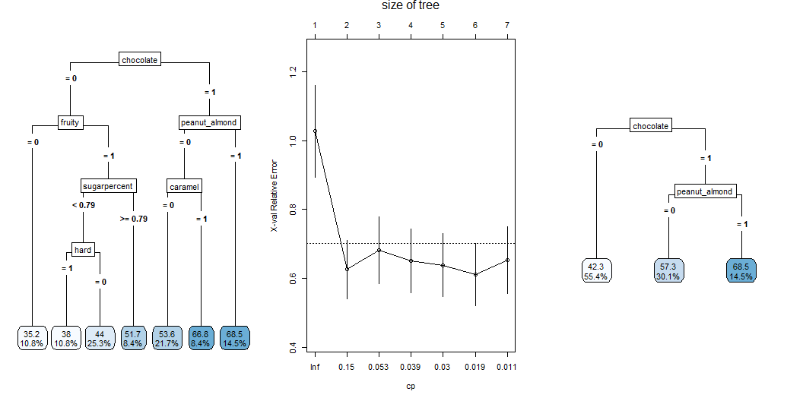
Decision tree
Besides the multiple regression, I also applied a tree-based model (decision tree) to find characteristics of a favorable candy (see figures below). For this, I used the simplified candy data set (excluding the odd candies ‘Apple Caramel Pops’ and ‘Tootsie Pop’). To avoid overfitting of an initially grown decision tree, a suitable complexity parameter (CP) has been chosen. Here, a tree size of 2 seems suitable as this size meets both a low cross validation error and a low model complexity (middle figure). The resulting post-pruned decision tree with the size of 2 is shown below (right figure).
Regression tree: rpart(formula = winpercent ~ ., data = candy_cleaned[, -1]) Variables actually used in tree construction: [1] caramel chocolate fruity hard peanut_almond sugarpercent Root node error: 17837/83 = 214.91 n= 83 CP nsplit rel error xerror xstd 1 0.399896 0 1.00000 1.02732 0.132820 2 0.057241 1 0.60010 0.62596 0.085059 3 0.049449 2 0.54286 0.68100 0.097029 4 0.031279 3 0.49341 0.65122 0.093141 5 0.028814 4 0.46214 0.63894 0.091791 6 0.012604 5 0.43332 0.61137 0.090922 7 0.010000 6 0.42072 0.65365 0.097354

Slide 14
The pruning results in a decision tree with only three leaf nodes. Nonetheless, similar as found for our multiple regression model approach, the decision tree defines ‘chocolate’ and ‘peanut_almond’ as most relevant candy characteristics whereby also declaring ‘fruity’ as not relevant.
Below, I listed the candies ending up in the far right leaf node (highest predicted win rate). Even though the listed candies show all a win rate of > 50 % (indicating exclusively candies that are, on average, preferred over others), the overall range of win rates is rather high (about 50 to 84 %). Therefore, the model correctly finds attributes for favorable but not necessarily for the most favorable candies.
# A tibble: 12 × 2 candy winpercent <chr> <dbl> 1 Reese's Peanut Butter cup 84.2 2 Reese's Miniatures 81.9 3 Snickers 76.7 4 Reese's pieces 73.4 5 Reese's stuffed with pieces 72.9 6 Peanut butter M&M's 71.5 7 Nestle Butterfinger 70.7 8 Peanut M&Ms 69.5 9 Snickers Crisper 59.5 10 Baby Ruth 56.9 11 Mr Good Bar 54.5 12 Almond Joy 50.3

Slide 15
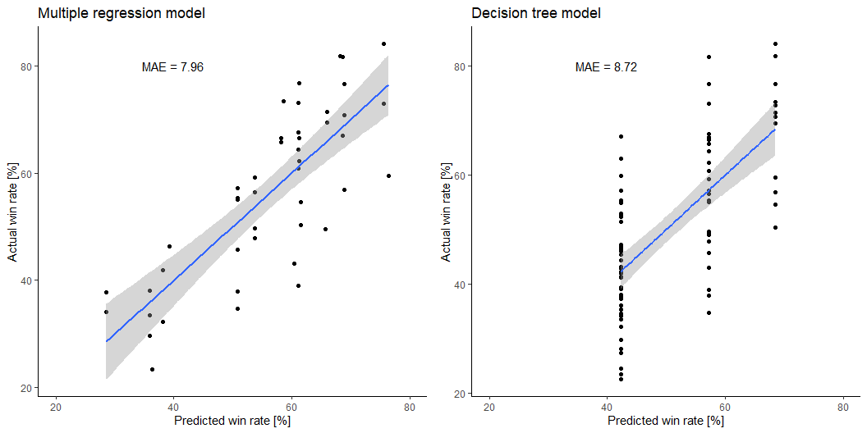
Model comparison and business recommendation
To further assess both models, I plotted the predicted win rates (using the optimized model ‘nonfruity2.lm’) versus the actual win rates below (left scatter plot). An equivalent plot has been done using the decision tree model (right scatter plot). Overall, the multiple regression model shows a lower MAE compared to the decision tree and is also capable of predicting a much larger range of win rates.

Slide 17
Business Recommendation
Characteristics | Consider for new candy product?
chocolate | definitely
sugar (>0.5 percentile) | yes
peanuts or almonds | yes
multi-piece | optional (rather not)
rice/wafer/cooky component | optional (rather yes)
bar form | optional (rather not)
A business recommendation can be translated from the multiple regression model: a successful candy should be not fruity and further have the following characteristics (ordered by importance with key characteristics in bold):

Slide 18
All remaining characteristics (‘nougat’, ‘caramel’, ‘hard’) are not relevant. Following the outlined recommendations should result in a candy that his, on average, mostly preferred over other ones (83 out of 100 times).

